Slide 1
23ECE498 – PROJECT PHASE I
EVALUATION I
Design of an Efficient FPGA-Oriented FFT Framework Employing Quartic Polynomial Estimation for RF Applications
TEAM: B057
Dheeraj Reddy B BL.EN.U4ECE23112
Vaibhavi C R BL.EN.U4ECE23152
Name of the Guide: Dr. Parul Mathur
Name of the Evaluator:
Dr. Ashish Goswami
Mr. Swaminadhan Rajula

Slide 2
INTRODUCTION
Modern RF systems require efficient processing and analysis of signals in the frequency domain.
The Fast Fourier Transform (FFT) is widely used to convert signals from the time domain into the frequency domain.
FFT significantly reduces the computational complexity compared with direct Discrete Fourier Transform (DFT) computation.
Two-Dimensional FFT (2D FFT) extends frequency-domain analysis to two-dimensional data.
FFT processing is useful in applications involving multidimensional signal analysis, imaging, beamforming, and spectral processing.
FPGA platforms provide parallel processing capability, high throughput, and reconfigurability, making them suitable for real-time signal-processing applications.
This project focuses on developing an FPGA-oriented 2D FFT framework integrated with Quartic Polynomial Estimation for RF applications.

Slide 3
MOTIVATION
RF applications require accurate and fast frequency analysis.
Conventional implementations can have high computational complexity.
Real-time processing requires low latency and high throughput.
FPGA provides parallelism and efficient hardware implementation.
Frequency estimation becomes challenging for signals containing multiple sinusoidal components.
There is a need for an optimized framework that combines efficient FFT processing with Quartic Polynomial Estimation.
PROBLEM STATEMENT
RF signal analysis requires accurate and computationally efficient spectral processing. Implementing 2D FFT and frequency-estimation techniques on FPGA involves challenges such as:
High computational complexity
Hardware resource utilization
Memory requirements Processing latency
Timing constraints
Therefore, an optimized and modular FPGA-oriented framework is required to perform efficient 2D FFT processing and accurate frequency estimation for RF signal analysis.

Slide 4
Sub-Objective
OBJECTIVE
To design and mathematically optimize a Quartic Polynomial Estimator-based Two-Dimensional Fast Fourier Transform algorithm for FPGA implementation, enabling efficient and accurate spectral analysis of RF signals and establishing the foundation for a high-performance VLSI architecture.
Study the mathematical principles of 2D FFT and QPE.
Optimize the algorithm for FPGA implementation.
Design modular FPGA-compatible functional blocks.
Verify the algorithm using sinusoidal test signals.
Perform fixed-point and timing analysis.
Develop a scalable framework for future real-time RF applications.

Slide 5
Problem Statement
RF signal analysis requires accurate and computationally efficient spectral processing.
Implementing 2D FFT and frequency-estimation techniques on FPGA involves challenges such as:
High computational complexity
Hardware resource utilization
Memory requirements
Fixed-point precision
Processing latency
Timing constraints
Therefore, an optimized and modular FPGA-oriented framework is required to perform efficient 2D FFT processing and accurate frequency estimation for RF signal analysis.

Slide 6
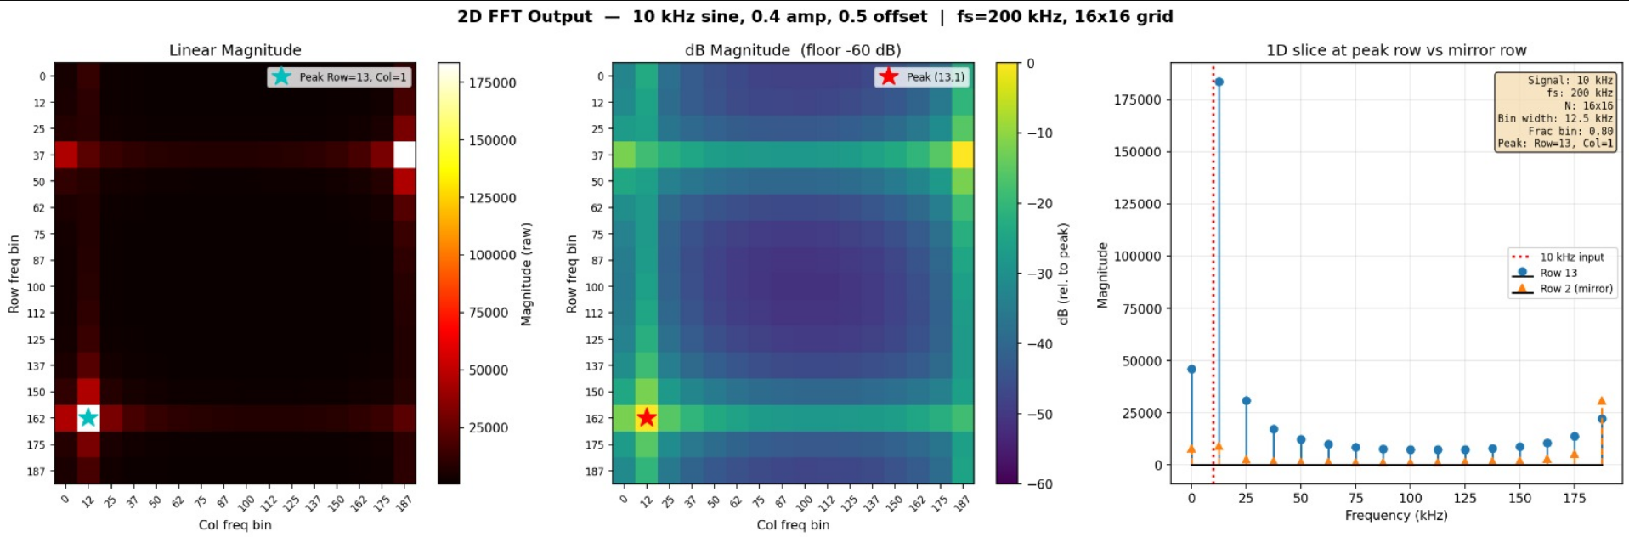
Partial Results and Analysis
Simulation of 2D FFT for IP Blocks
Freq:10KHz Amp:0.4 Offset:0.5

Slide 7
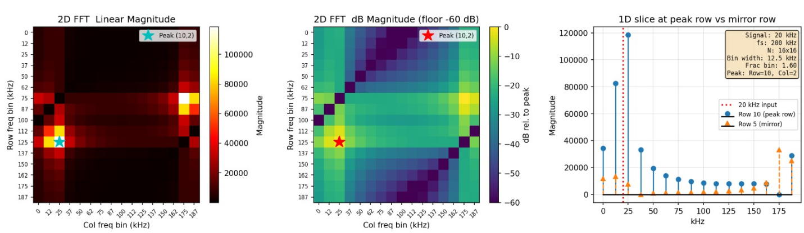
Partial Results and Analysis
Simulation of 2D FFT for IP Blocks
Freq:20KHz Amp:0.4 Offset:0.5

Slide 8
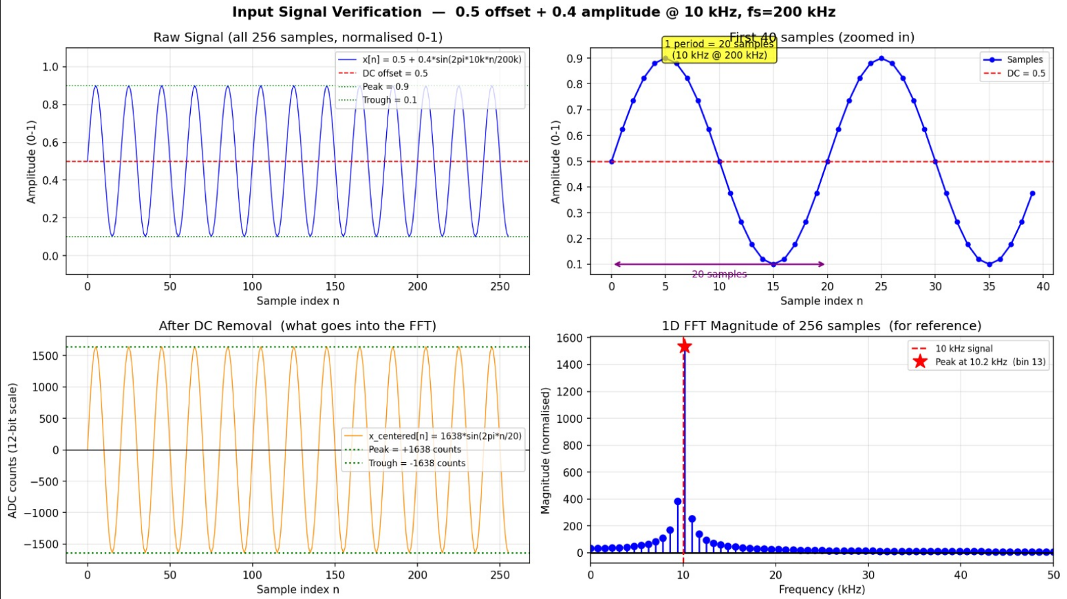
Partial Results and Analysis
Simulation for Input frequency and testbench

Slide 9
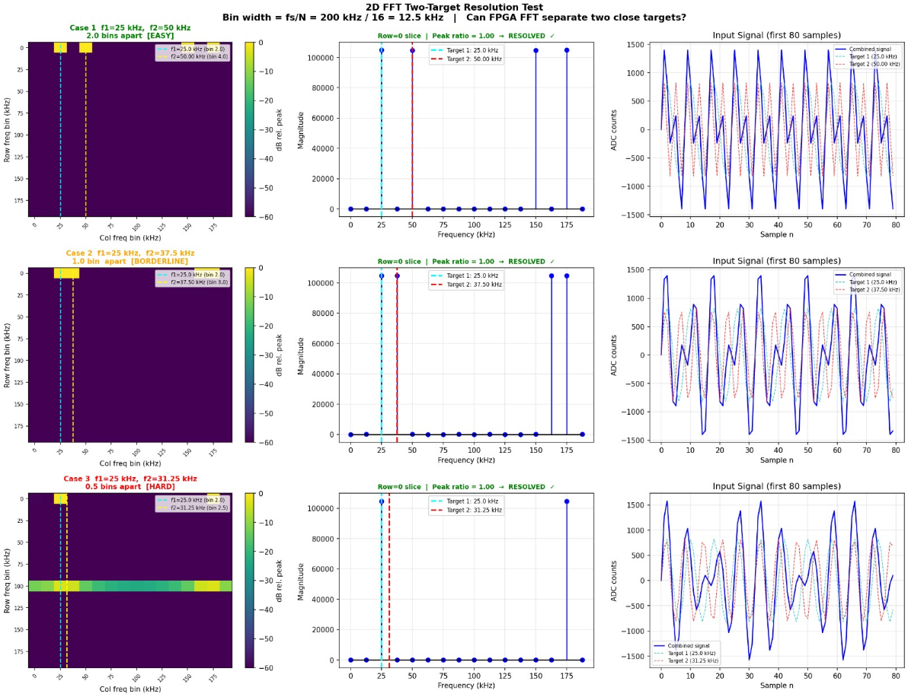
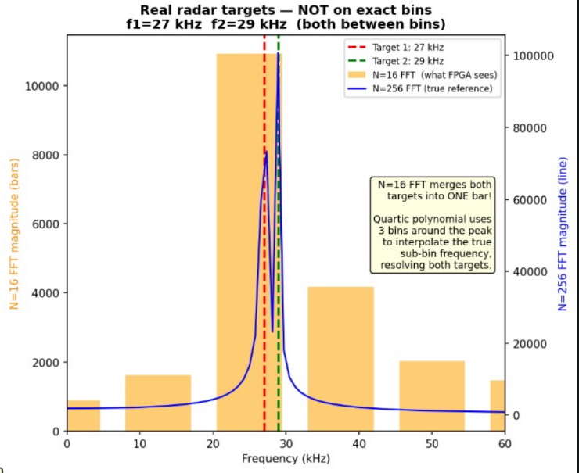
Partial Results and Analysis
Simulation of 2D FFT with Two Targets for IP Blocks
Freq:20KHz Amp:0.4 Offset:0.5

Slide 10
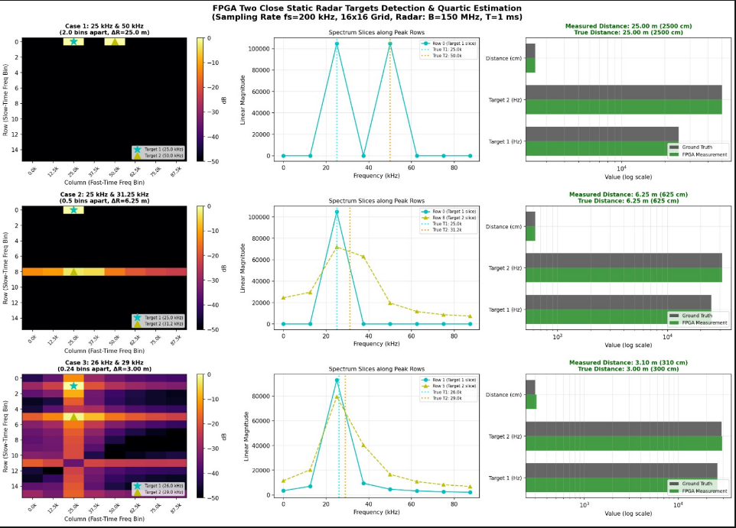
Partial Results and Analysis
Simulation of 2D FFT and Quartic Polynomial Estimation Alogirthm with Two Targets for IP Blocks
Freq:20KHz Amp:0.4 Offset:0.5

Slide 11
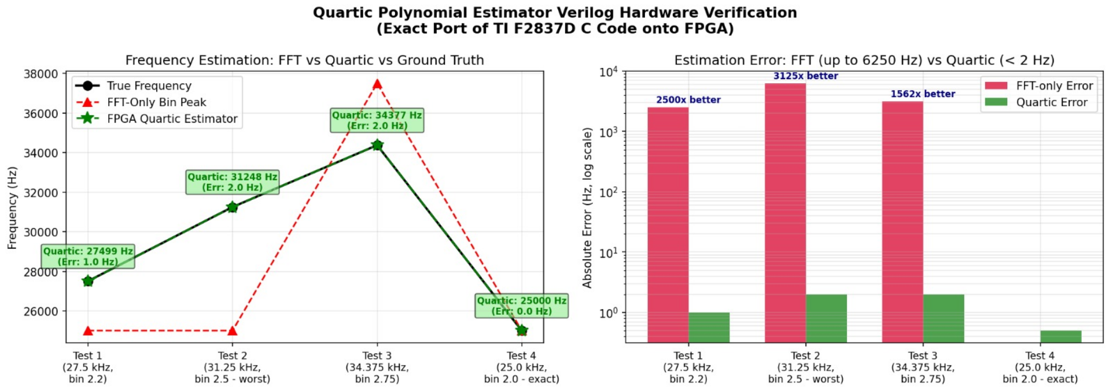
Partial Results and Analysis
Simulation of Quartic Polynomial Estimator vs 2D FFT:

Slide 12
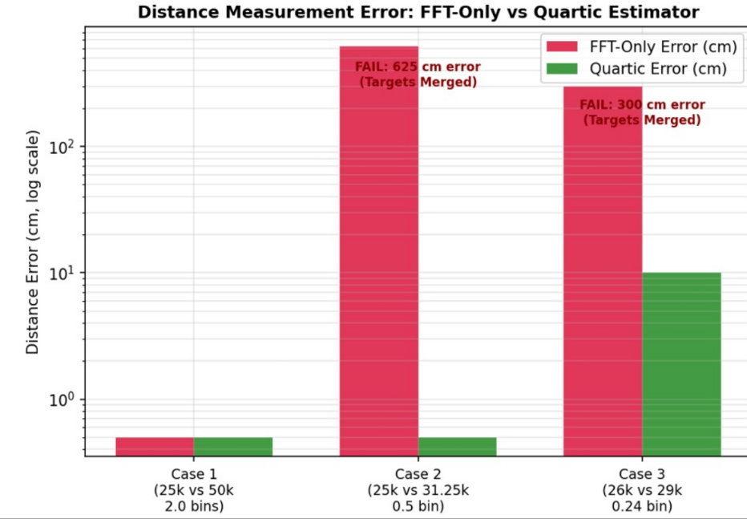
Partial Results and Analysis
Simulation of Quartic Polynomial Estimator vs 2D FFT:

Slide 13
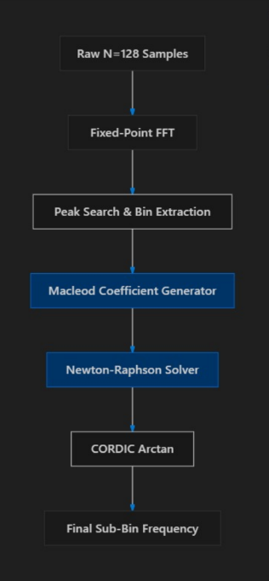
Proposed Architecture Blocks:
Input Interface
FFT Processing Unit
Arithmetic Units
Memory Buffers
QPE Processing Unit
Control Logic
Output Interface
Methodology
Study 2D FFT and QPE algorithms.
Mathematically analyse and optimize the algorithms.
Perform fixed-point analysis.
Design modular FPGA-compatible architecture.
Simulate using sinusoidal test signals.
Verify accuracy and spectral output.
Prepare the design for FPGA implementation.

Slide 14
TIMELINE
Month | Planned Work
July 2026 | Literature survey, study of 2D FFT and QPE, mathematical formulation
August 2026 | Algorithm optimization, fixed-point analysis, architecture design, initial simulation
September 2026 | Development and verification of FPGA processing blocks
October 2026 | Integration of IP blocks and system-level verification
November 2026 | Hardware validation, performance analysis, GUI development, documentation

Slide 15
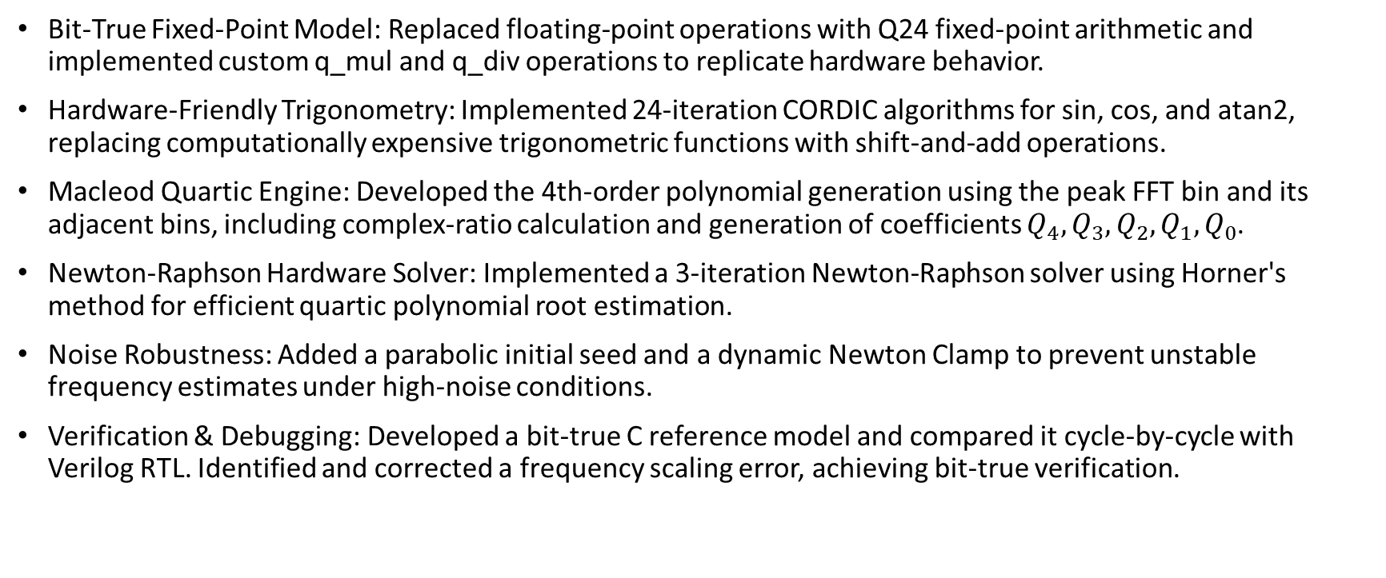
Work Done So Far…
Bit-True Fixed-Point Model: Replaced floating-point operations with Q24 fixed-point arithmetic and implemented custom q_mul and q_div operations to replicate hardware behavior.
Hardware-Friendly Trigonometry: Implemented 24-iteration CORDIC algorithms for sin, cos, and atan2, replacing computationally expensive trigonometric functions with shift-and-add operations.
Macleod Quartic Engine: Developed the 4th-order polynomial generation using the peak FFT bin and its adjacent bins, including complex-ratio calculation and generation of coefficients $Q_{4},Q_{3},Q_{2},Q_{1},Q_{0}$.
Newton-Raphson Hardware Solver: Implemented a 3-iteration Newton-Raphson solver using Horner's method for efficient quartic polynomial root estimation.
Noise Robustness: Added a parabolic initial seed and a dynamic Newton Clamp to prevent unstable frequency estimates under high-noise conditions.
Verification & Debugging: Developed a bit-true C reference model and compared it cycle-by-cycle with Verilog RTL. Identified and corrected a frequency scaling error, achieving bit-true verification.

Slide 16
REFERENCES
G. Narayanan and D. G. Kurup, “A Quartic Polynomial Based Approach for Multi-Sinusoidal Frequency Estimation,” International Journal of Electrical and Electronic Engineering & Telecommunications, 2024.
R. Palisetty et al., “FPGA Implementation of Efficient 2D-FFT Beamforming for On-Board Processing in Satellites,” IEEE VTC-Fall, 2023.
H.-Y. Chin, P.-Y. Tsai, and S.-Y. Lee, “Implementation of a Two-Dimensional FFT/IFFT Processor for Real-Time High-Resolution Synthetic Aperture Radar Imaging,” IEEE SiPS, 2021.
J. S. Kim et al., “FPGA Architecture for 2D Discrete Fourier Transform Based on 2D Decomposition for Large-Sized Data,” IEEE SiPS, 2009.

